Slide 1
An Analysis of Career Trajectories Salary & Experience Across Global Industries
Aswin Raj V P

Slide 2
Introduction & Objectives
Objective of the Analysis:
To analyze a salary survey dataset and explore career trajectories across global industries
How do salary and experience vary across different industries?
What role do factors such as education, gender, and location play in salary differences?

Slide 3
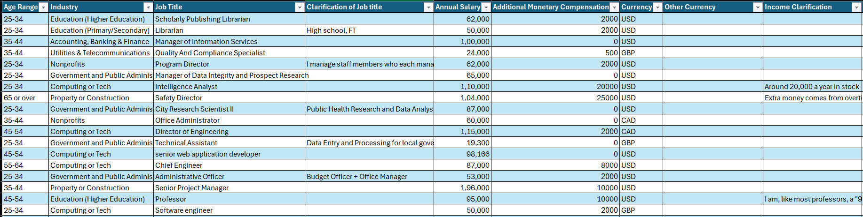
Dataset Overview
Dataset attributes (e.g., Age Range, Industry, Job Title, Annual Salary, Years of Experience, Education Level, Gender, etc.).
Dataset size : 28,103
Key columns: Annual Salary, Industry, Job Title, etc.

Slide 4
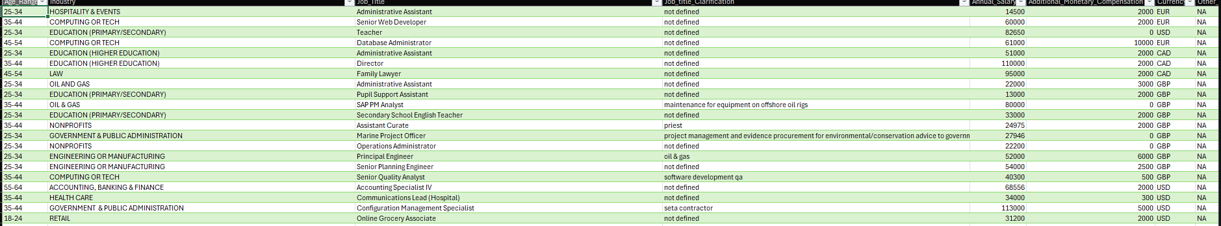
Data Cleaning & Preprocessing
Handling missing values
Standardizing data types
Addressing inconsistent values
Handling outliers

Slide 5
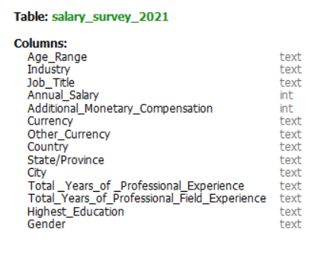
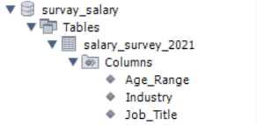
Database Creation in MySQL
Database Setup
Data Import

Slide 6
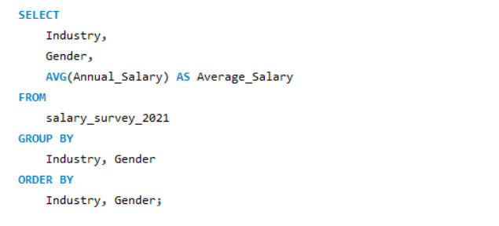
Key Queries Executed
Average Salary by Industry & Gender
Salary Distribution by Education Level
Job Titles with the Highest Salary in Each Country
Total Compensation by Job Title and Experience

Slide 7
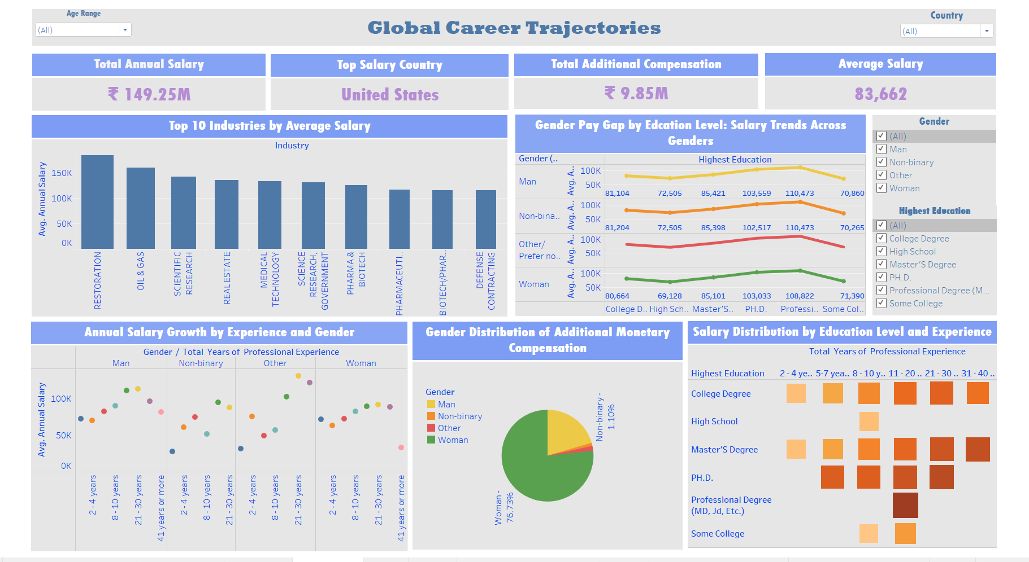
Dashboard

Slide 8
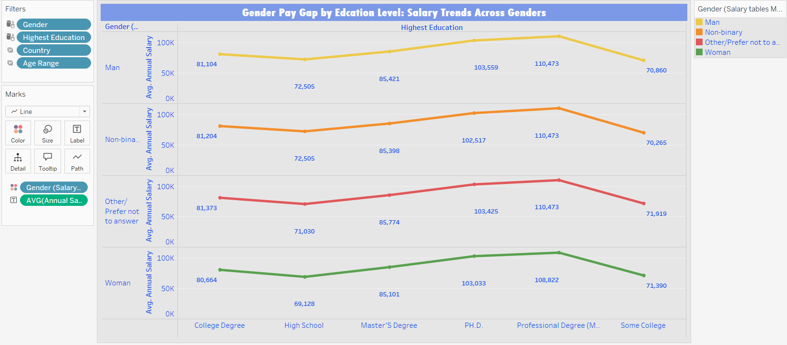
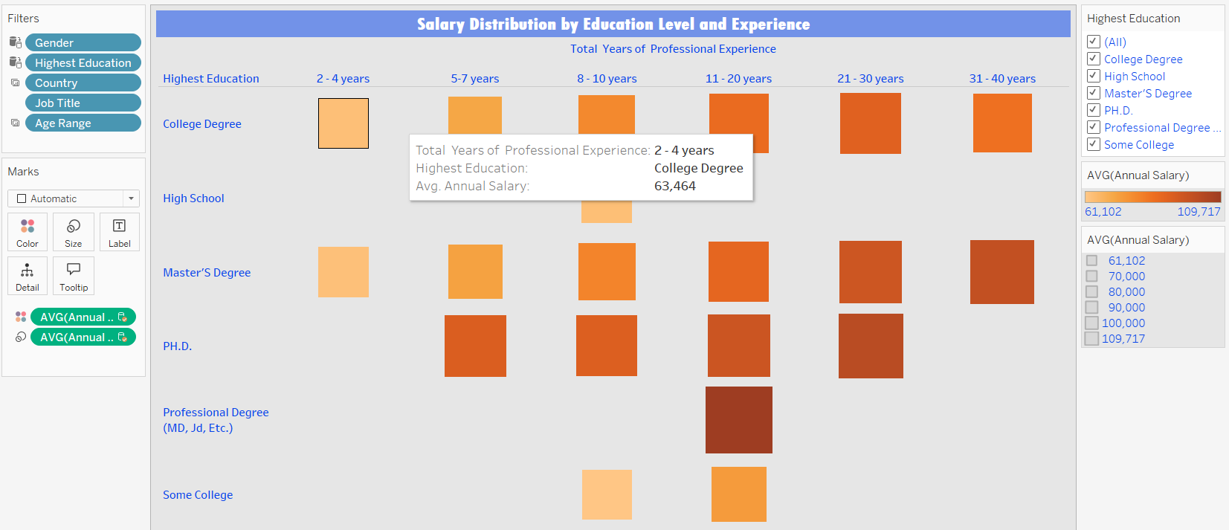
Tableau Dashboard Overview
Visualizations
Gender Pay Gap trends across industries and experience
Additional Compensation breakdown by gender
Salary Distributions across Industries, Gender, Experience, and Education Levels
Key Interactive Filters:
Gender
Education Level
Age Range
Country

Slide 9
Insights
Men earn more than women and non-binary individuals, with the gap widening with experience.
Higher education leads to significantly higher salaries.
Salary grows with experience, but men see more substantial increases.
Oil & Gas, Technology, and Pharmaceuticals offer the highest salaries.

Slide 10
Recommendations
Ensure equal pay practices and transparency.
Promote higher education for better salary outcomes.
Ensure equal salary growth for all genders.
Investigate salary disparities in tech and finance.
Ensure equitable compensation for all genders.

Slide 11
Conclusion
This analysis highlights key trends in salary growth and the impact of gender, education, and experience.
Higher education is a key factor in boosting salary potential.
Addressing these disparities and promoting fairness will be essential for building a more equitable workforce."

Slide 12
Thank You

